Slide 1




Tables
A set of different data items with identical definitions.
They are defined so that the individual items in the set can be accessed via a reference, known as subscript.
Also known as array.
FEU – EAST ASIA COLLEGE
Information Technology Department

Slide 2
Tables
A table is defined by using the Occurs clause in the Data Division.
The Occurs clause may not be used on a level 01 or 77 data item.
Table Declaration:
Data Division.
01 Month-Table.
03 Month-Name Pic X(9) Occurs 5 Times.
The occurs clause specifies that Month-Name field is repeated 5 times; therefore Month-Name has 5 elements. The subscript associated with the 1st element is 1, and subscript associated with the last is 5.

Slide 3
Tables
The Occurs clause may also be used at the Group Level to create an array containing several elementary items.
Table Declaration:
Data Division.
01 State-Table.
03 State-Abbrev-Name Occurs 5 Times.
05 State-Abbrev Pic X(2).
05 State-Name Pic X(30).
The occurs clause is specified only at the Group Level. Therefore, the pairing of State-Abbrev and State-Name repeats 5 times.

Slide 4
Populating a Table
Table Declaration:
Data Division.
01 Month-Table.
03 Month-Name Pic X(9) Occurs 5 Times.
One way to get the individual month names into the table is to move them individually.
  Move “January” to Month-Name (1).
  Move “February” to Month-Name (2).
The individual fields can be referenced by using the subscript.
  Display Month-Name (1).

Slide 5
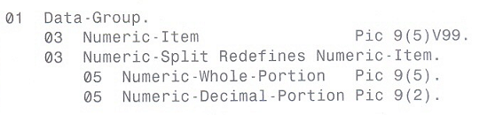
The Redefines Clause
Redefines allows you to specify different Picture clause for a previously defined data item.
The syntax of the REDEFINES clause is as follows:
Level-number data-name-1 REDEFINES data-name-2

Slide 6
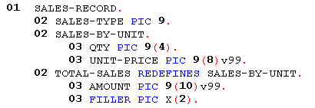
The Redefines Clause

Slide 7
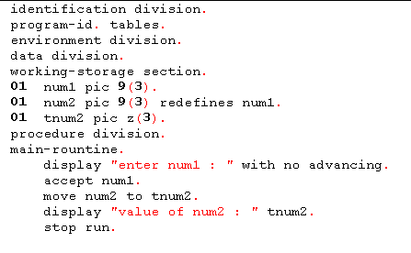
The Redefines Clause

Slide 8
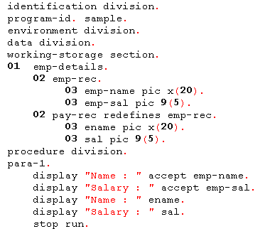
The Redefines Clause

Slide 9
The Redefines Clause
A better way to initialize table is to use a Data Division feature called the Redefines clause.
In this case, the contents of the table can be defined in Working-Storage Section, instead of being loaded in the Procedure Division.
You can take advantage of the Redefines clause to populate a table in the Working-Storage Section.

Slide 10
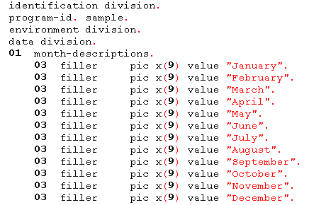
First, an area is defined in the working-storage section with the different month descriptions listed in order. Example:

Slide 11
The next step is to redefine this data area with the month table. Then the table is automatically populated, or loaded, with the appropriate data values.
When you use redefines to establish initial values for the elements of a table, you cannot use the Initialize verb to reset the table to these values. Initialize moves spaces or zeros, as appropriate, to each element of a table, thus clearing your predefined values.

Slide 12
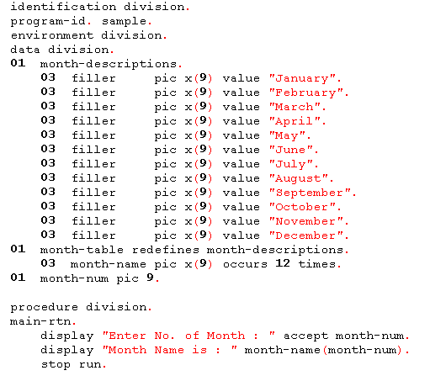

Slide 13
ARRAY DECLARATION
Sample-2
01 DEPT-NAMES.
05 FILLER PIC X(7) VALUE "MENS ".
05 FILLER PIC X(7) VALUE "WOMEN ".
05 FILLER PIC X(7) VALUE "INFANTS".
05 FILLER PIC X(7) VALUE "GIRLS ".
05 FILLER PIC X(7) VALUE "BOYS ".
01 DEPT-TABLE REDEFINES DEPT-NAMES.
05 D-NAME PIC X(7) OCCURS 5 TIMES.

Slide 14
PROCEDURE DIVISION.
:
:
:
ACCEPT DEPT-NO.
IF DEPT-NO IS NUMERIC
IF DEPT-NO > 0 AND DEPT-NO < 6
DISPLAY D-NAME(DEPT-NO)
ELSE
DISPLAY "INVALID VALUE".
ELSE
DISPLAY “ENTER A NUMERIC VALUE”.

Slide 15
ARRAY DECLARATION
Sample-3
01 BONUS-VALUES.
05 FILLER PIC X(23) VALUE
"UPPER MANAGEMENT 300000".
05 FILLER PIC X(23) VALUE
"MIDDLE MANAGEMENT200000".
05 FILLER PIC X(23) VALUE
"SUPPORT 100000".
01 BONUS-TABLE REDEFINES BONUS-VALUES.
05 JOB-BONUS OCCURS 3 TIMES.
10 JOB-CATEGORY PIC X(17).
10 BONUS PIC 9(4)V99.

Slide 16
ARRAY DECLARATION
Sample-4
01 DEPT-VALUES
05 FILLER PIC X(17) VALUE "MENS SMITH ".
05 FILLER PIC X(17) VALUE "WOMENS JOHNSON ".
05 FILLER PIC X(17) VALUE "INFANTS LEE ".
05 FILLER PIC X(17) VALUE "GIRLS HALL ".
05 FILLER PIC X(17) VALUE "BOYS WILLIAMSON".
01 DEPT-TABLE REDEFINES DEPT-VALUES.
05 DEPARTMENTS OCCURS 5 TIMES.
10 DEPT-NAME PIC X(7).
10 MANAGER-NAME PIC X(10).

Slide 17
PROCEDURE DIVISION.
:
:
:
DISPLAY “MANAGER DEPARTMENT”.
PERFORM WITH TEST AFTER VARYING
CTR FROM 1 BY 1 UNTIL CTR=5
DISPLAY MANAGER-NAME (CTR)
WITH NO ADVANCING
DISPLAY DEPT-NAME (CTR)
END-PERFORM

Slide 18
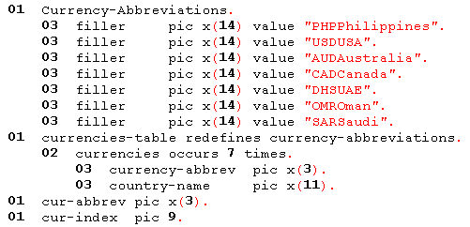
The preceding examples have shown the simplest use of a table. Another use for a table is as a lookup. You can use small table to find associated information.

Slide 19
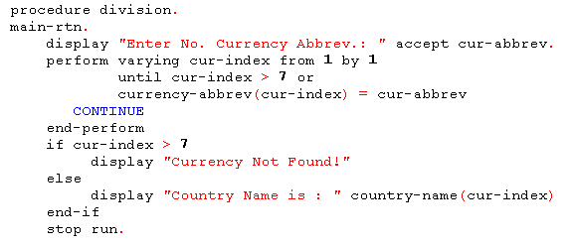

Slide 20
ASSIGNMENT:
ENTER NO. OF ELEMENTS : 5
ENTER THE ELEMENTS :
3
1
4
5
6
EVEN NUMBERS ARE : 4, 6
ODD NUMBERS ARE : 3, 1, 5

